Slide 1
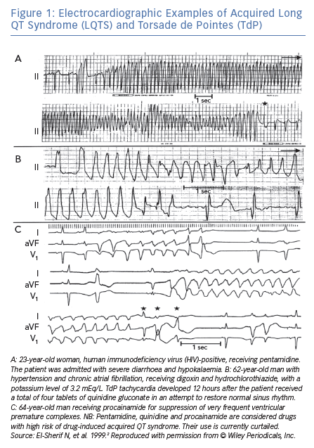
El-Sherif N, Turitto G, Boutjdir M
Electrocardiographic Examples of Acquired Long QT Syndrome (LQTS) and Torsade de Pointes (TdP)
Citation: Arrhythmia & Electrophysiology Review 2019;8(2):122–30.
https://doi.org/10.15420/aer.2019.8.3

