Slide 1
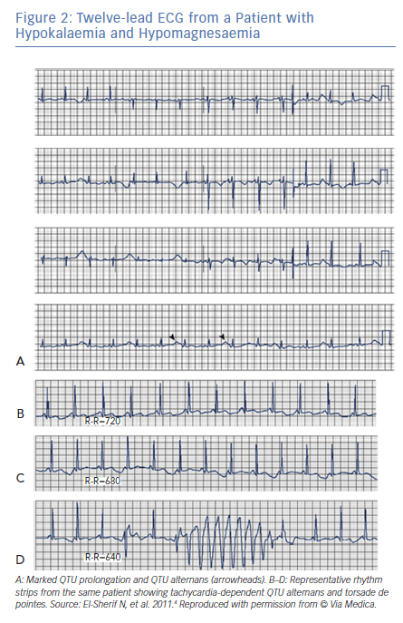
El-Sherif N, Turitto G, Boutjdir M
Twelve-lead ECG from a Patient with Hypokalaemia and Hypomagnesaemia
Citation: Arrhythmia & Electrophysiology Review 2019;8(2):122–30.
https://doi.org/10.15420/aer.2019.8.3

