Slide 1

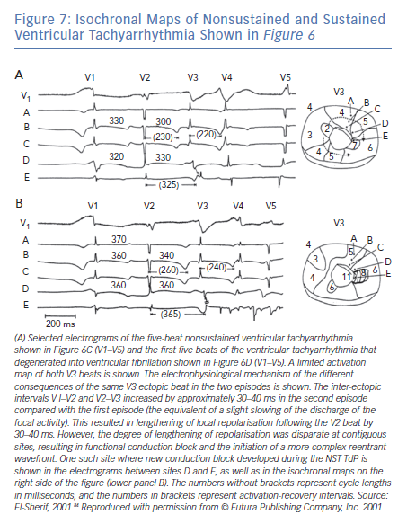
El-Sherif N, Turitto G, Boutjdir M
Isochronal Maps of Nonsustained and Sustained Ventricular Tachyarrhythmia Shown in Figure 6
Citation: Arrhythmia & Electrophysiology Review 2019;8(2):122–30.
https://doi.org/10.15420/aer.2019.8.3

