Slide 1
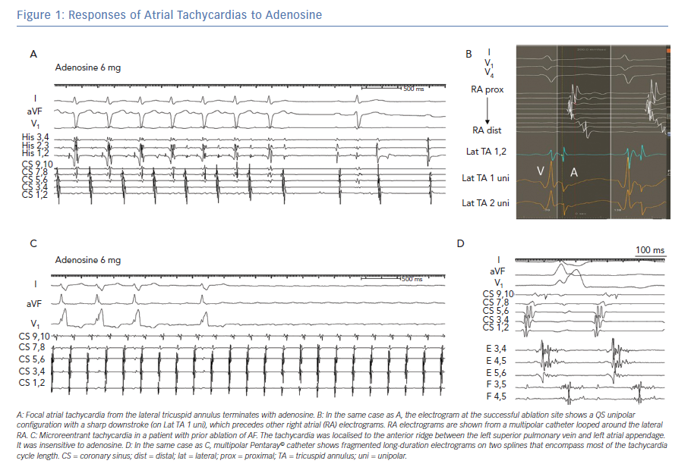
Markowitz SM, Thomas G, Liu CF, Cheung JW, Ip JE, Lerman BB
Responses of Atrial Tachycardias to Adenosine
Citation: Arrhythmia & Electrophysiology Review 2019;8(2):131–7.
https://doi.org/10.15420/aer.2019.17.2

