Slide 1
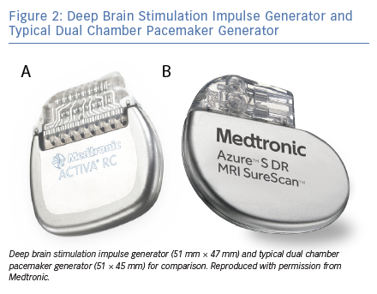
Elliott M, Momin S, Fiddes B, Farooqi F, Sohaib A
Deep Brain Stimulation Impulse Generator and Typical Dual Chamber Pacemaker Generator
Citation: Arrhythmia & Electrophysiology Review 2019;8(2):138–42.
https://doi.org/10.15420/aer.2018.63.2

