Slide 1
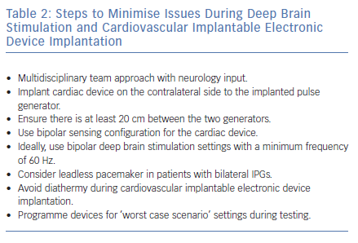
Elliott M, Momin S, Fiddes B, Farooqi F, Sohaib A
Steps to Minimise Issues During Deep Brain Stimulation and Cardiovascular Implantable Electronic Device Implantation
Citation: Arrhythmia & Electrophysiology Review 2019;8(2):138–42.
https://doi.org/10.15420/aer.2018.63.2

