Slide 1
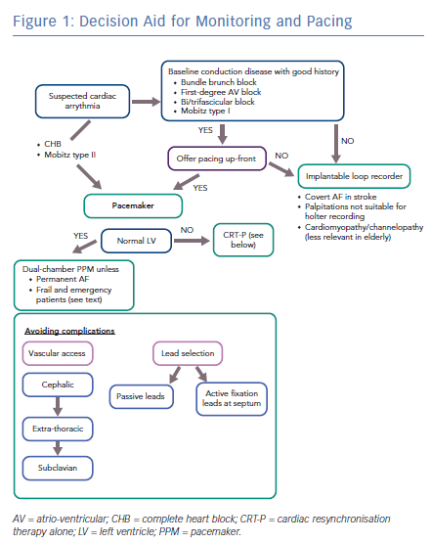
Lim WY, Prabhu S
Decision Aid for Monitoring and Pacing
Citation: Arrhythmia & Electrophysiology Review 2019;8(2):143–6.
https://doi.org/10.15420/aer.2019.3.4

