Slide 1
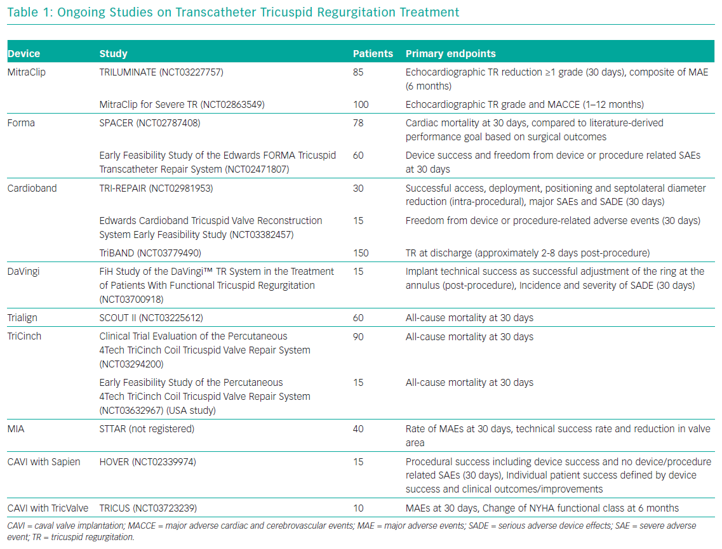
Curio J, Demir OM, Pagnesi M, Mangieri A, Giannini F, Weisz G, Latib A
Ongoing Studies on Transcatheter Tricuspid Regurgitation Treatment
Citation: Interventional Cardiology Review 2019;14(2):54–61.
https://doi.org/10.15420/icr.2019.5.1

