Slide 1
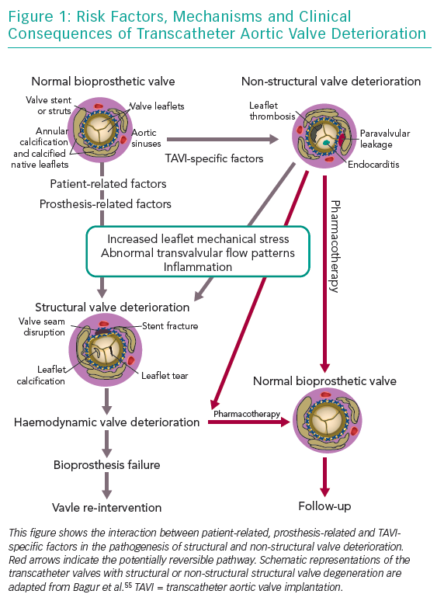
Costa G, Criscione E, Todaro D, Tamburino C, Barbanti M
Risk Factors, Mechanisms and Clinical Consequences
Citation: Interventional Cardiology Review 2019;14(2):62–9.
https://doi.org/10.15420/icr.2019.4.2

