Slide 1
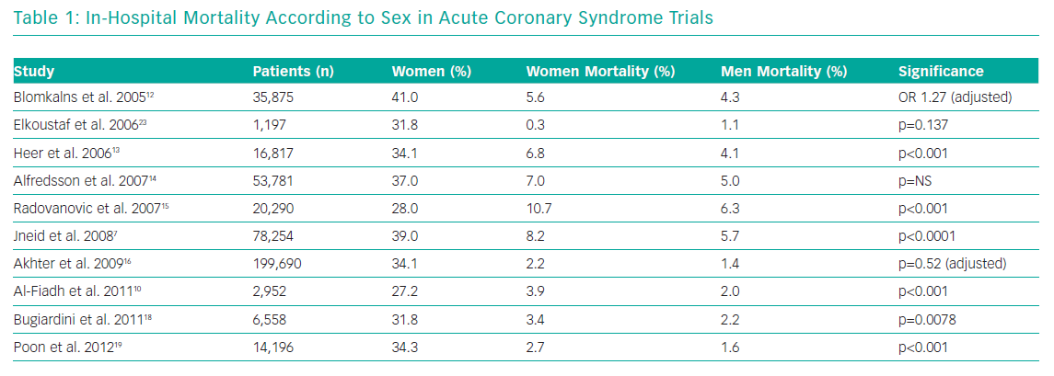
Rao U, Buchanan GL, Hoye A
In-Hospital Mortality According to Sex in Acute Coronary Syndrome Trials
Citation: Interventional Cardiology Review 2019;14(2):70–5.
https://doi.org/10.15420/icr.2019.09

