Slide 1
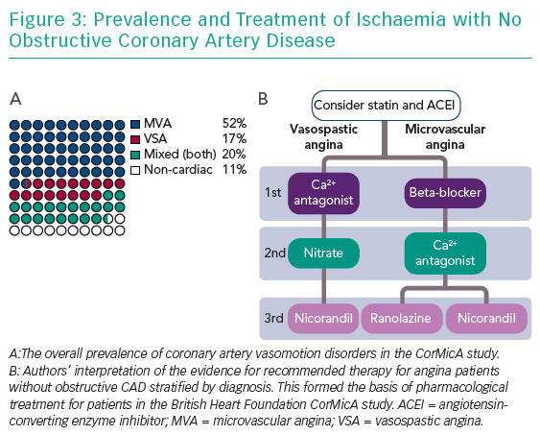
Ford T, Berry C
Prevalence and Treatment of Ischaemia
Citation: Interventional Cardiology Review 2019;14(2):76–82.
https://doi.org/10.15420/icr.2019.04.R1

