Slide 1
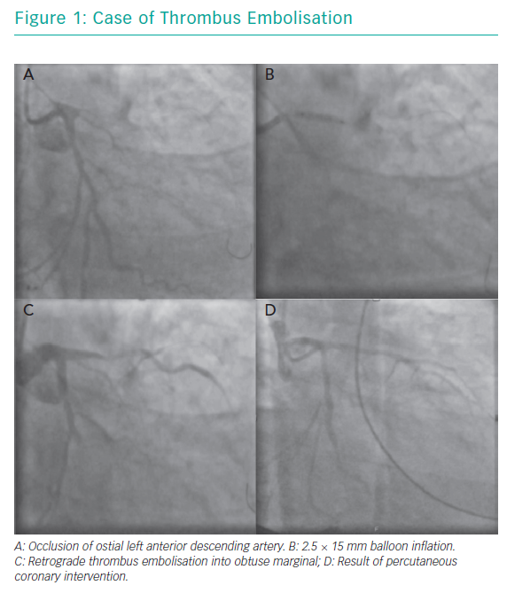
Choudry FA, Weerackody RP, Jones DA, Mathur A
Case of Thrombus Embolisation
Citation: Interventional Cardiology Review 2019;14(2):95–101.
https://doi.org/10.15420/icr.2019.11

