Slide 1
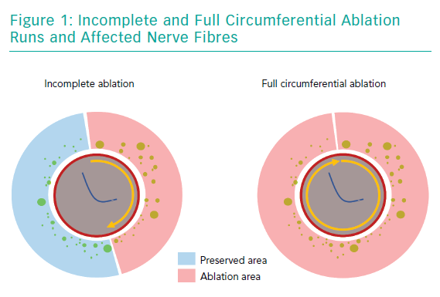
Lurz P, Fengler K
Incomplete and Full Circumferential Ablation Runs and Affected Nerve Fibres
Citation: Interventional Cardiology Review 2019;14(2):102–6.
https://doi.org/10.15420/icr.2019.03.R1

