Slide 1
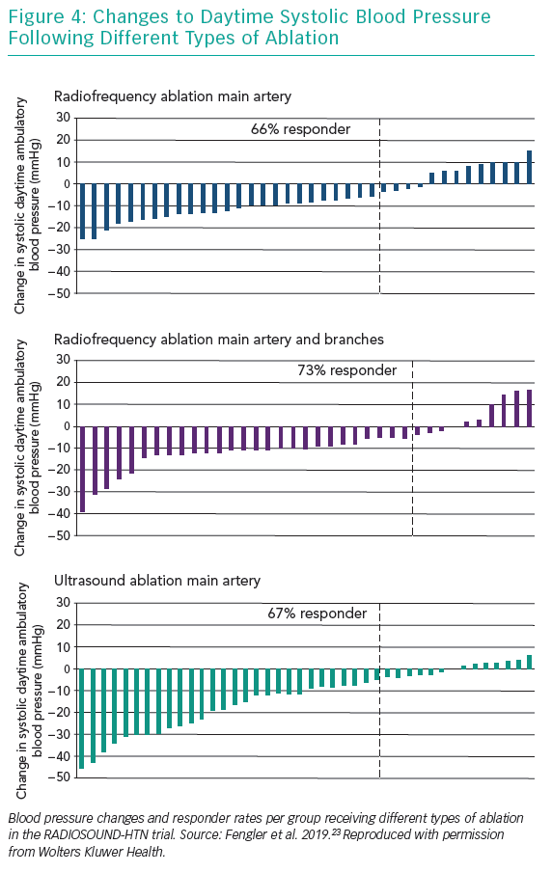
Lurz P, Fengler K
Changes to Daytime Systolic Blood Pressure Following Different Types of Ablation
Citation: Interventional Cardiology Review 2019;14(2):102–6.
https://doi.org/10.15420/icr.2019.03.R1

