Slide 1
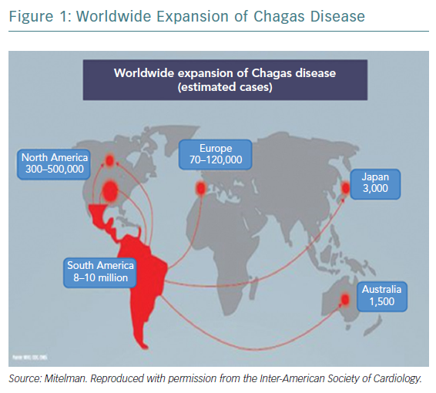
Martínez F, Perna E, Perrone SV, Liprandi AS
Worldwide Expansion of Chagas Disease
Citation: European Cardiology Review 2019;14(2):82–8
https://doi.org/10.15420/ecr.2018.30.2

