Slide 1
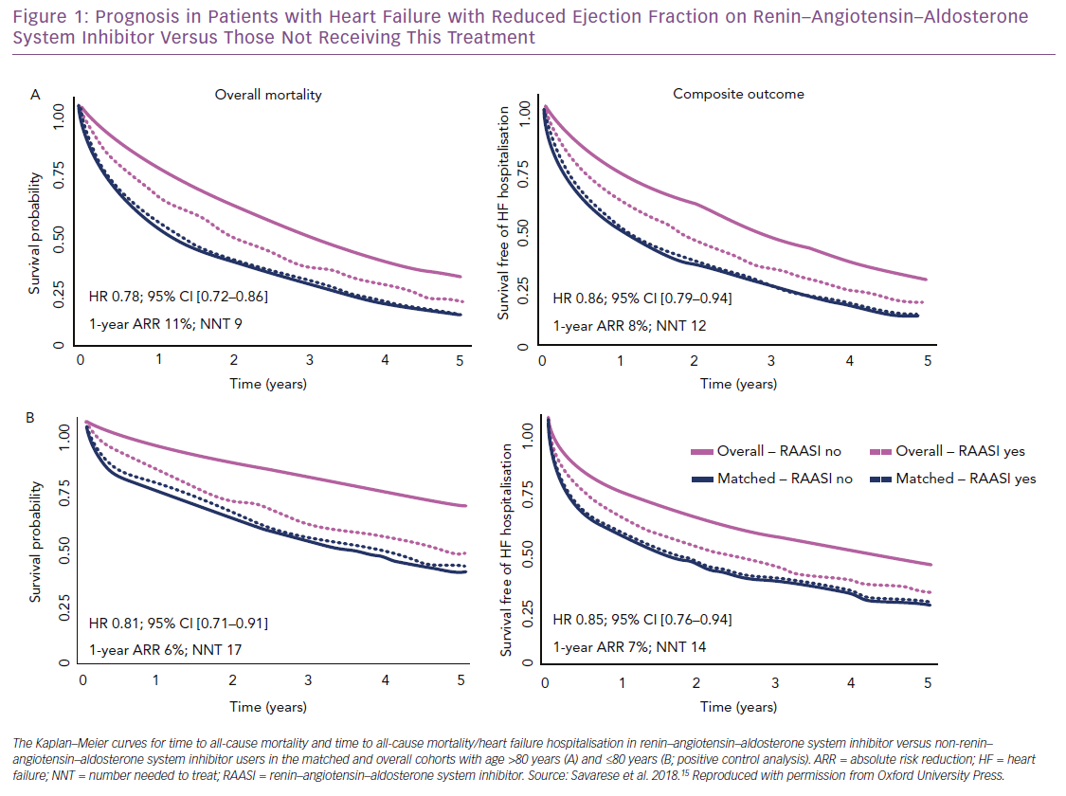
Stolfo D, Savarese G
Prognosis in Patients with Heart Failure
Citation: Cardiac Failure Review 2019;5(2):70–3.
https://doi.org/10.15420/cfr.2019.6.2

