Slide 1
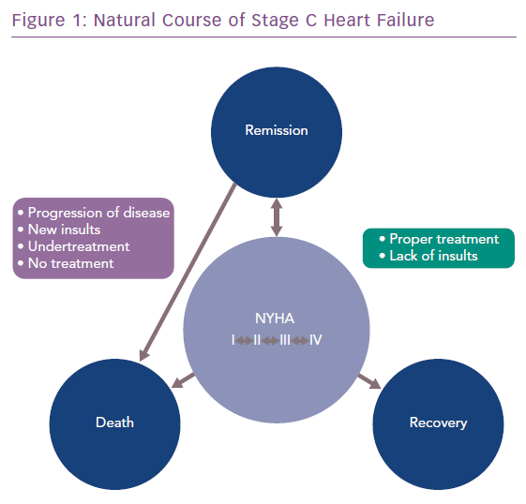
Papadimitriou L, Moore CK, Butler J, Long RC
Natural Course of Stage C Heart Failure
Citation: Cardiac Failure Review 2019;5(2):74–7.
https://doi.org/10.15420/cfr.2019.3.2

