Slide 1
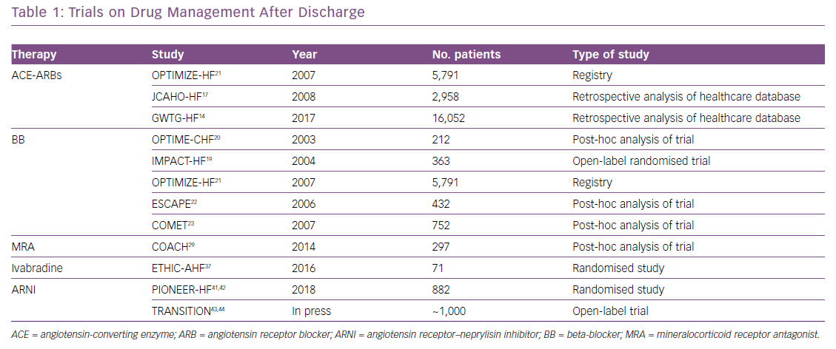
Iacovoni A, D'Elia E, Gori M, Oliva F, Lorini FL, Senni M
Trials on Drug Management After Discharge
Citation: Cardiac Failure Review 2019;5(2):78–82.
https://doi.org/10.15420/cfr.2018.46.2

