Slide 1
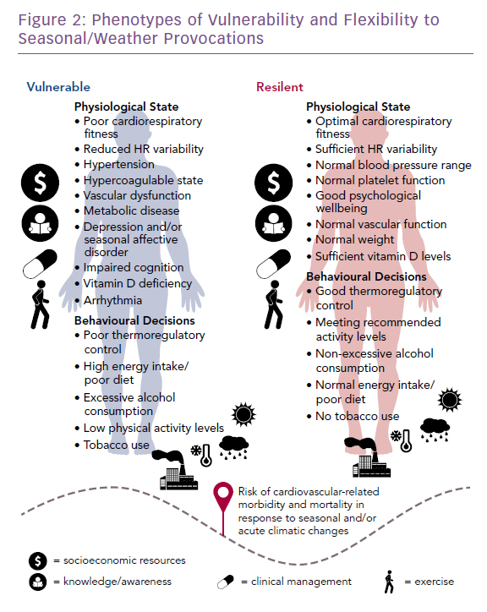
Stewart S, Moholdt TT, Burrell LM, Sliwa K, Mocumbi AO, McMurray JJ, Keates AK, Hawley JA
Phenotypes of Vulnerability and Flexibility to Seasonal/Weather Provocations
Citation: Cardiac Failure Review 2019;5(2):83–5.
https://doi.org/10.15420/cfr.2018.40.2

