Slide 1
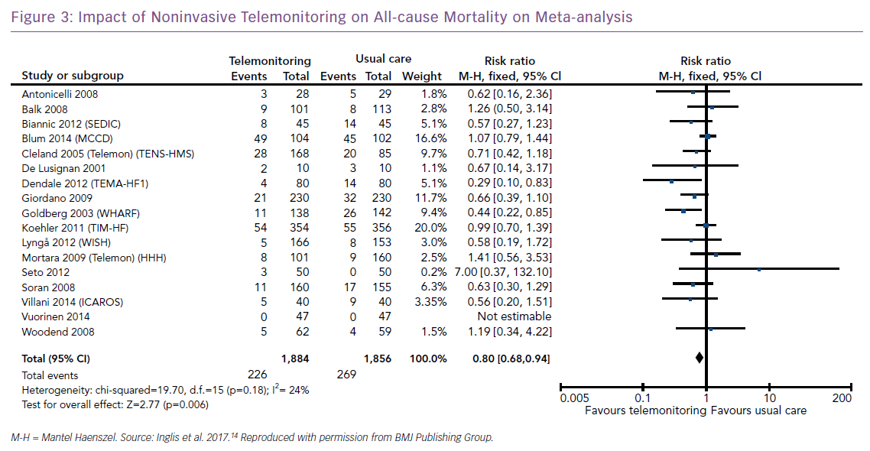
Brahmbhatt DH, Cowie MR
Impact of Noninvasive Telemonitoring
Citation: Cardiac Failure Review 2019;5(2):86–92.
https://doi.org/10.15420/cfr.2019.5.3

