Slide 1
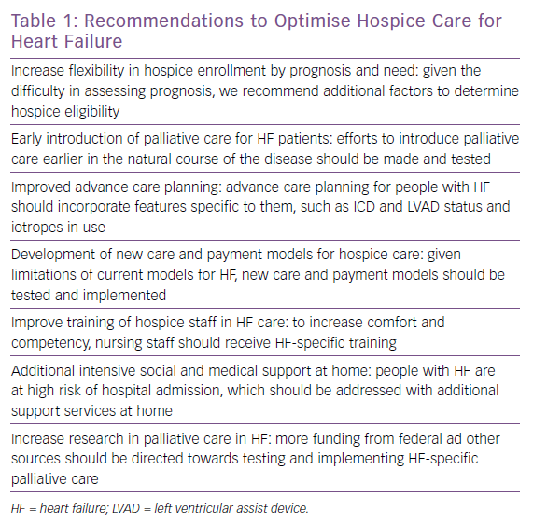
Cross SH, Kamal AH, Taylor Jr DH, Warraich HJ
Recommendations to Optimise Hospice Care for Heart Failure
Citation: Cardiac Failure Review 2019;5(2):93–8.
https://doi.org/10.15420/cfr.2019.2.2

