Slide 1
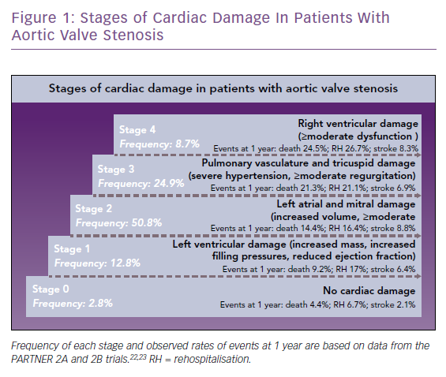
Spitzer E, Hahn RT, Pibarot P, Vries Td, Bax JJ, Leon MB, Van Mieghem NM
Stages of Cardiac Damage In Patients With Aortic Valve Stenosis
Citation: Cardiac Failure Review 2019;5(2):99–105.
https://doi.org/10.15420/cfr.2018.41.2

