Slide 1
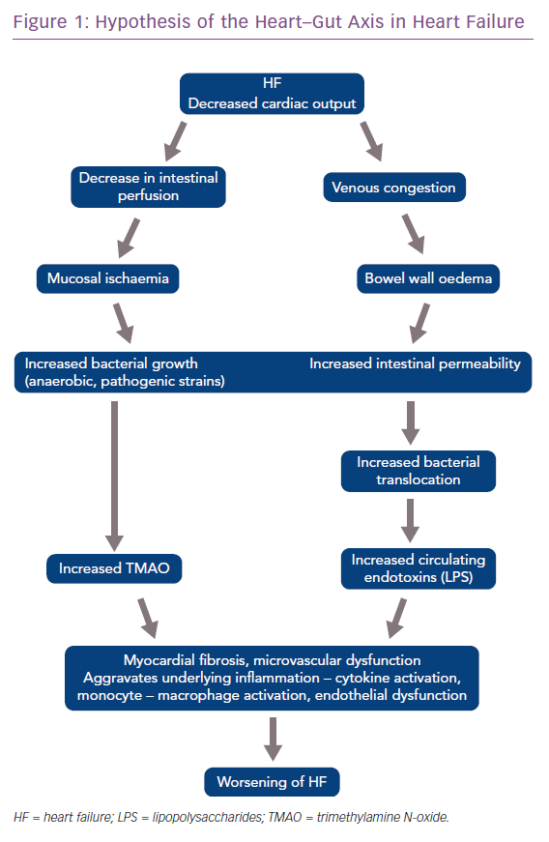
Harikrishnan S
Hypothesis of the Heart–Gut Axis in Heart Failure
Citation: Cardiac Failure Review 2019;5(2):119–22.
https://doi.org/10.15420/cfr.2018.39.2

