Slide 1
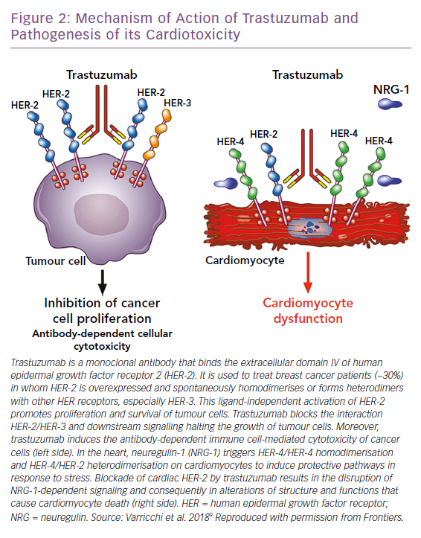
Cuomo A, Rodolico A, Galdieri A, Russo M, Campi G, Franco R, Bruno D, Aran L, Carannante A, Attanasio U, Tocchetti CG, Varricchi G, Mercurio V
Figure 2: Mechanism of Action of Trastuzumab and Pathogenesis of its Cardiotoxicity
Citation: Cardiac Failure Review 2019;5(2):112–8.
https://doi.org/10.15420/cfr.2018.32.2

