Slide 1
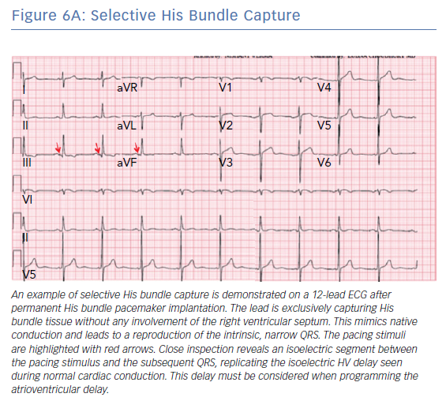
Verma N, Knight BP
Selective His Bundle Capture
Citation: Arrhythmia & Electrophysiology Review 2019;8(3):228–33.
https://doi.org/10.15420/aer.2019.15.3

