Slide 1

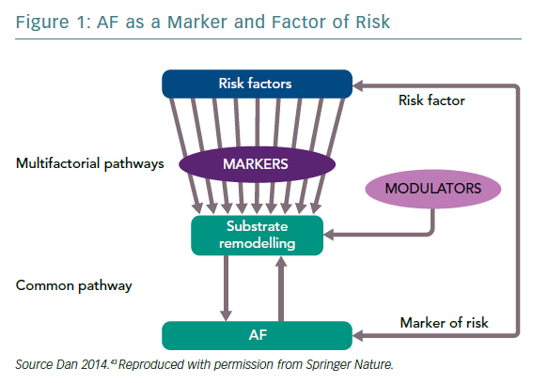
Dan GA
AF as a Marker and Factor of Risk
Citation: European Cardiology Review 2019;14(2):77–81
https://doi.org/10.15420/ecr.2019.8.1

