Slide 1
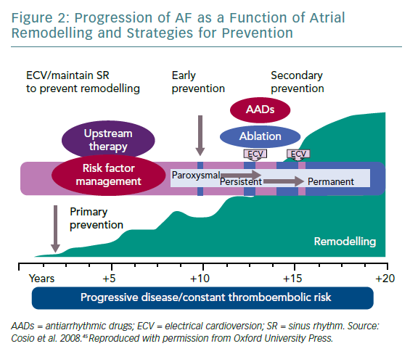
Dan GA
Progression of AF as a Function of Atrial Remodelling and Strategies for Prevention
Citation: European Cardiology Review 2019;14(2):77–81
https://doi.org/10.15420/ecr.2019.8.1

