Slide 1
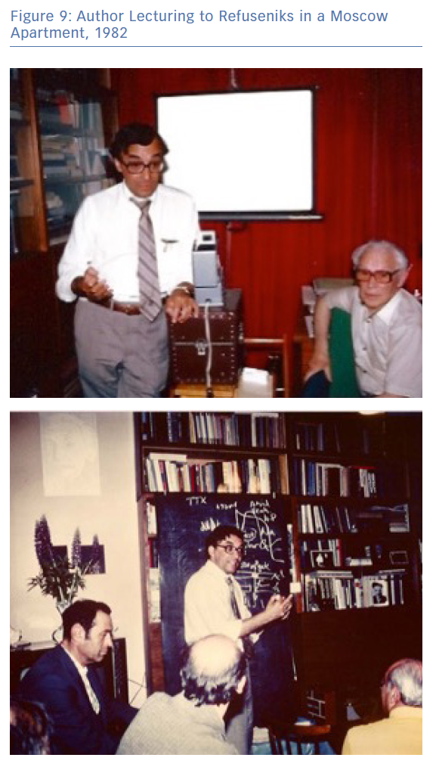
Zipes DP
Author Lecturing to Refuseniks in a Moscow Apartment, 1982
Citation: Arrhythmia & Electrophysiology Review 2019;8(3):156–60.
https://doi.org/10.15420/aer.2019.8.3.ED1

