Slide 1
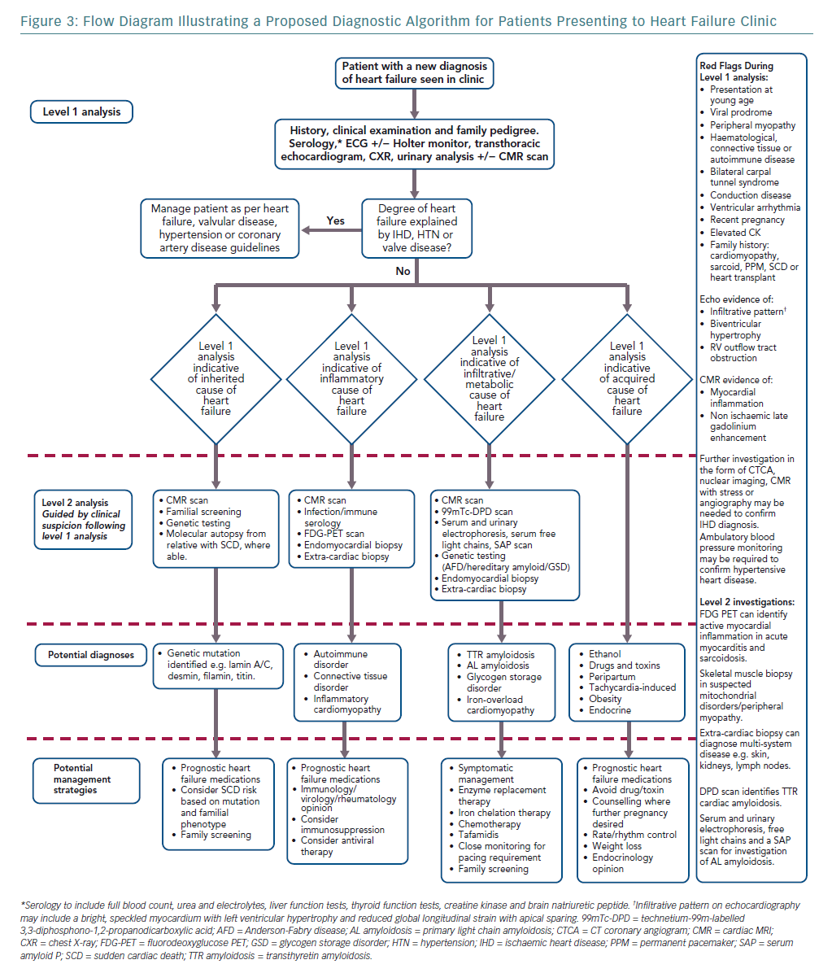
Cannie DE, Akhtar MM, Elliott P
Flow Diagram Illustrating a Proposed Diagnostic Algorithm
Citation: European Cardiology Review 2019;14(2):89–96
https://doi.org/10.15420/ecr.2019.19.2

