Slide 1
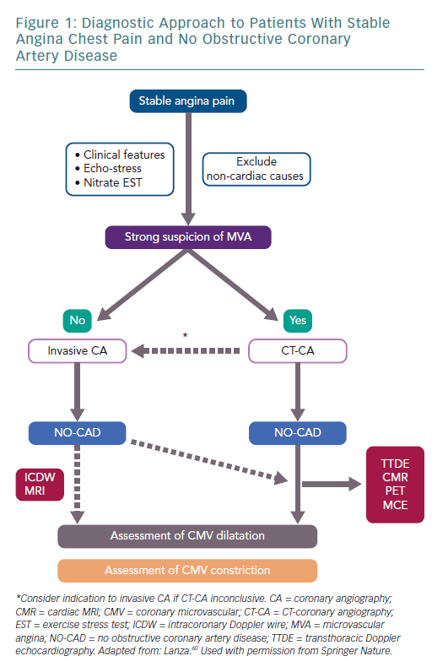
Lanza GA
Diagnostic Approach to Patients
Citation: European Cardiology Review 2019;14(2):97–102
https://doi.org/10.15420/ecr.2019.22.2

