Slide 1
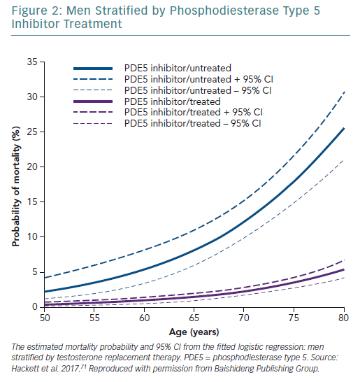
Kirby MG, Hackett G, Ramachandran S
Men Stratified by Phosphodiesterase Type 5 Inhibitor Treatment
Citation: European Cardiology Review 2019;14(2):103–10
https://doi.org/10.15420/ecr.2019.13.1

