Slide 1
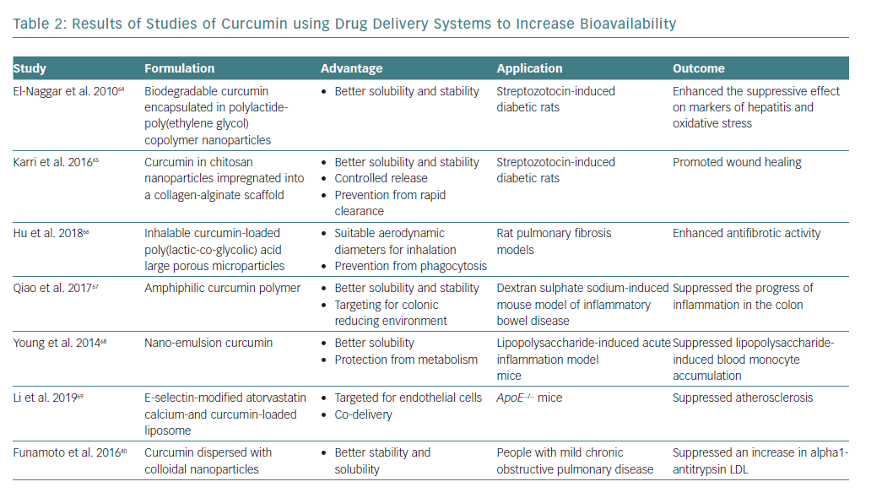
Shimizu K, Funamoto M, Sunagawa Y, Shimizu S, Katanasaka Y, Miyazaki Y, Wada H, Hasegawa K, Morimoto T
Results of Studies of Curcumin
Citation: European Cardiology Review 2019;14(2):117–22
https://doi.org/10.15420/ecr.2019.17.2

