Slide 1
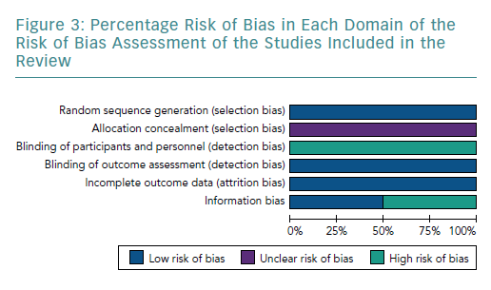
Sorathia N, Al-Rubaye H, Zal B
Percentage Risk of Bias in Each Domain of the Risk of Bias Assessment
Citation: European Cardiology Review 2019;14(2):123–9
https://doi.org/10.15420/ecr.2019.9.2

