Slide 1
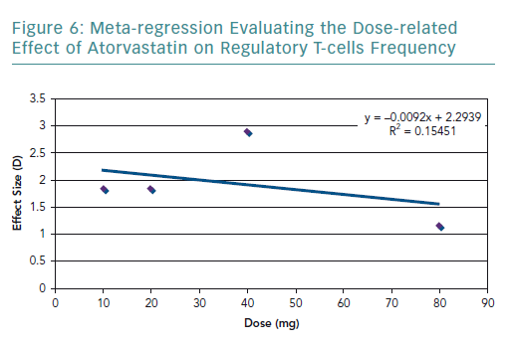
Sorathia N, Al-Rubaye H, Zal B
Meta-regression Evaluating the Dose-related Effect of Atorvastatin
Citation: European Cardiology Review 2019;14(2):123–9
https://doi.org/10.15420/ecr.2019.9.2

