Slide 1
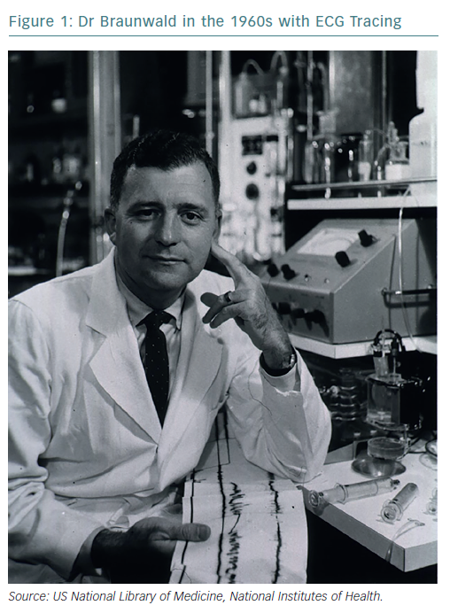
Braunwald E
Dr Braunwald in the 1960s with ECG Tracing
Citation: European Cardiology Review 2019;14(2):130–3
https://doi.org/10.15420/ecr.2019.14.2.CM1

