Slide 1
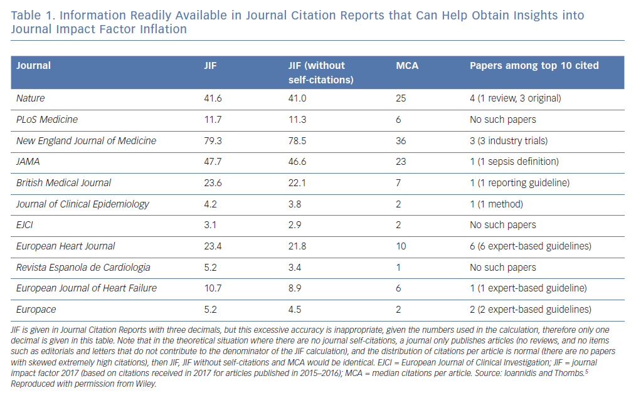
Katritsis DG
Information Readily Available in Journal Citation Reports
Citation: Arrhythmia & Electrophysiology Review 2019;8(3):153–5.
https://doi.org/10.15420/aer.2019.8.3.FO1

