Slide 1
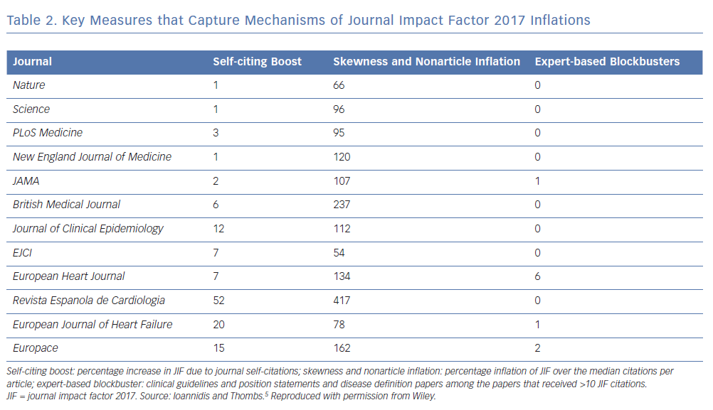
Katritsis DG
Key Measures that Capture Mechanisms
Citation: Arrhythmia & Electrophysiology Review 2019;8(3):153–5.
https://doi.org/10.15420/aer.2019.8.3.FO1

