Slide 1
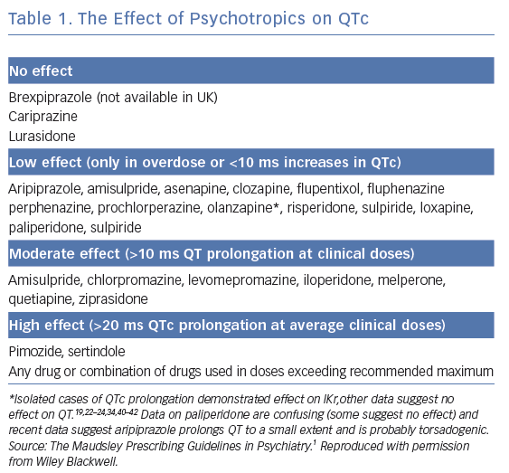
Lambiase PD, De Bono J, Lowe M, Turley A, Slade A, Collinson J, Rajappan K, Harris S, Collinson J, Carpenter V, Daw H, Hall A, Roberts E, Holding S, Paisey J, Sopher M, Wright I, Wiles B, Taylor D
The Effect of Psychotropics on QTc
Citation: Arrhythmia & Electrophysiology Review 2019;8(3):161–5.
https://doi.org/10.15420/aer.2019.8.3.G1

