Slide 1
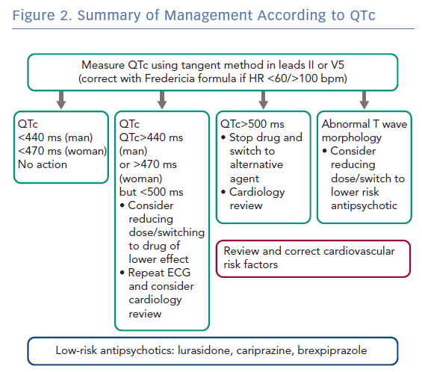
Lambiase PD, De Bono J, Lowe M, Turley A, Slade A, Collinson J, Rajappan K, Harris S, Collinson J, Carpenter V, Daw H, Hall A, Roberts E, Holding S, Paisey J, Sopher M, Wright I, Wiles B, Taylor D
Summary of Management According to QTc
Citation: Arrhythmia & Electrophysiology Review 2019;8(3):161–5.
https://doi.org/10.15420/aer.2019.8.3.G1

