Slide 1
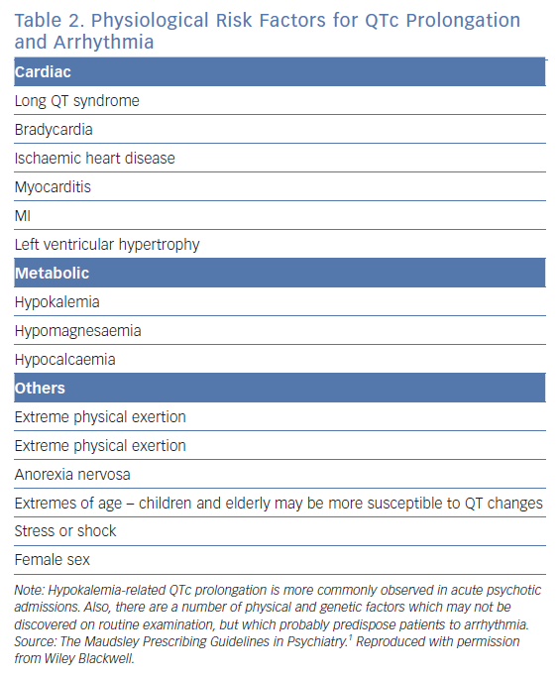
Lambiase PD, De Bono J, Lowe M, Turley A, Slade A, Collinson J, Rajappan K, Harris S, Collinson J, Carpenter V, Daw H, Hall A, Roberts E, Holding S, Paisey J, Sopher M, Wright I, Wiles B, Taylor D
Physiological Risk Factors for QTc Prolongation and Arrhythmia
Citation: Arrhythmia & Electrophysiology Review 2019;8(3):161–5.
https://doi.org/10.15420/aer.2019.8.3.G1

