Slide 1
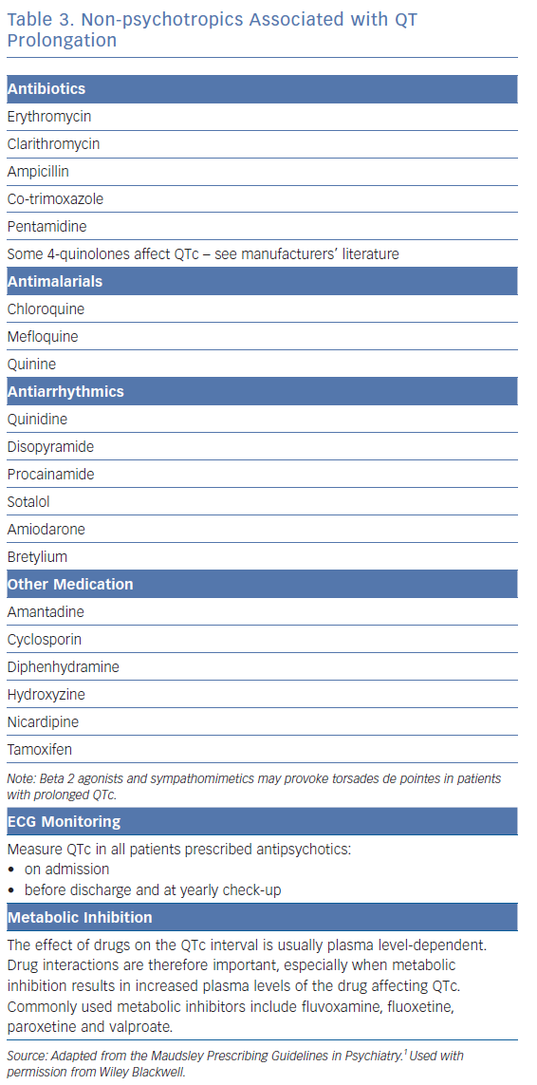
Lambiase PD, De Bono J, Lowe M, Turley A, Slade A, Collinson J, Rajappan K, Harris S, Collinson J, Carpenter V, Daw H, Hall A, Roberts E, Holding S, Paisey J, Sopher M, Wright I, Wiles B, Taylor D
Non-psychotropics Associated with QT Prolongation
Citation: Arrhythmia & Electrophysiology Review 2019;8(3):161–5.
https://doi.org/10.15420/aer.2019.8.3.G1

