Slide 1
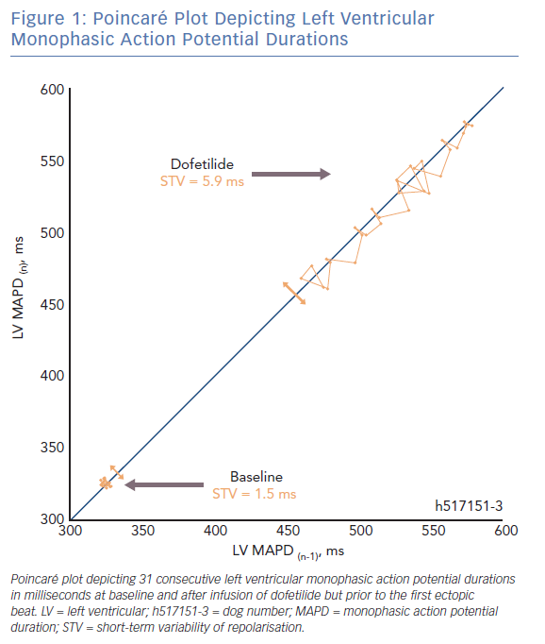
Smoczynska A, Beekman HD, Vos MA
Poincaré Plot Depicting Left Ventricular Monophasic Action Potential Durations
Citation: Arrhythmia & Electrophysiology Review 2019;8(3):166–72.
https://doi.org/10.15420/aer.2019.16.2

