Slide 1
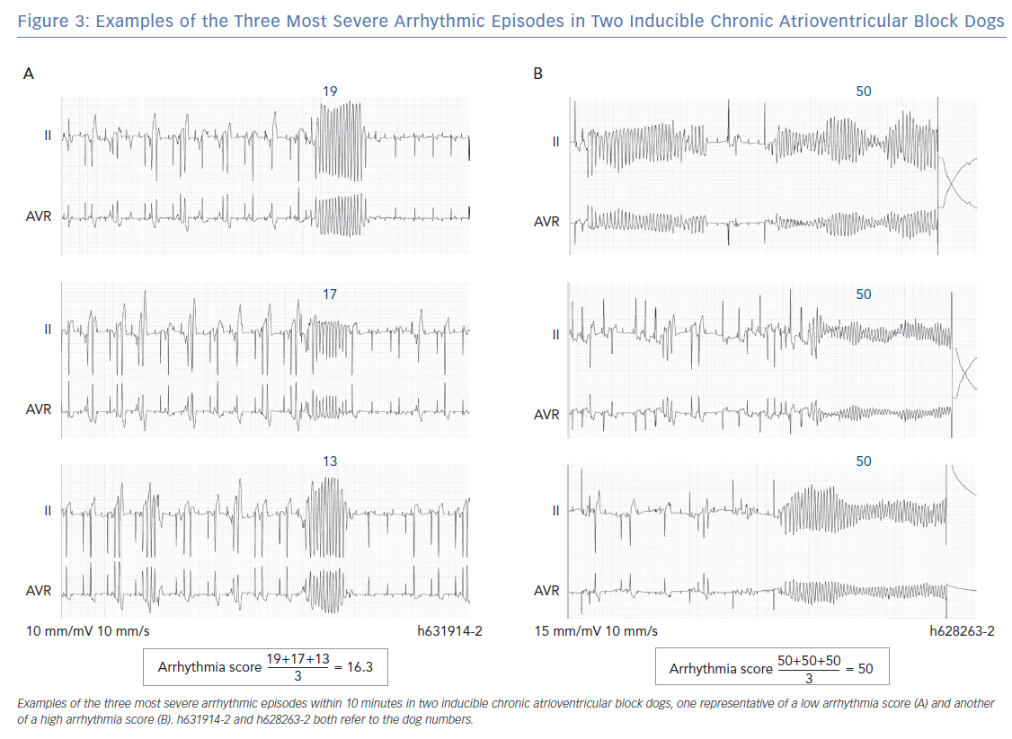
Smoczynska A, Beekman HD, Vos MA
Examples of the Three Most Severe Arrhythmic Episodes
Citation: Arrhythmia & Electrophysiology Review 2019;8(3):166–72.
https://doi.org/10.15420/aer.2019.16.2

