Slide 1
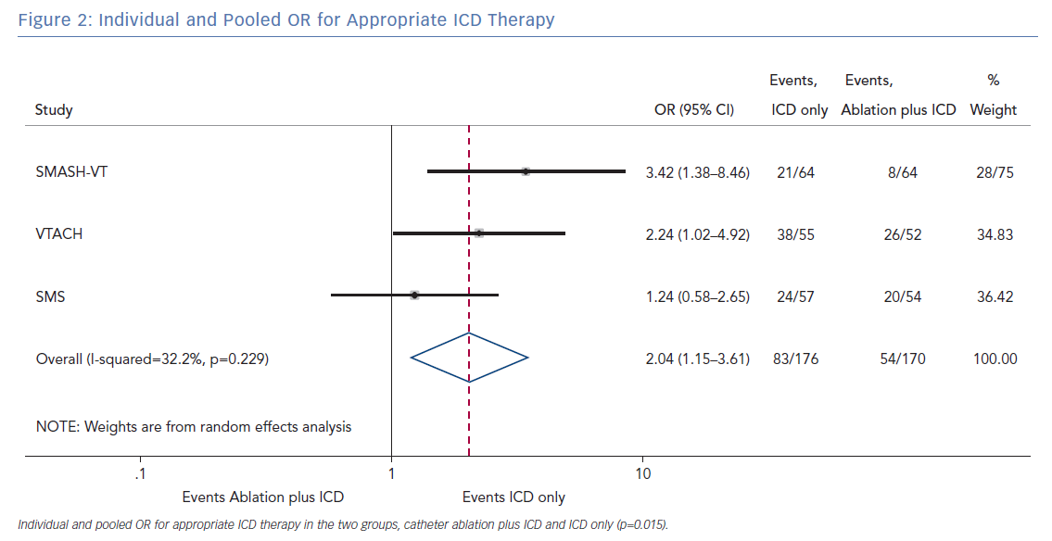
Tilz RR, Eitel C, Lyan E, Yalın K, Liosis S, Vogler J, Brueggemann B, Eitel I, Heeger C, AlTurki A, Proietti R
Individual and Pooled OR for Appropriate ICD Therapy
Citation: Arrhythmia & Electrophysiology Review 2019;8(3):173–9.
https://doi.org/10.15420/aer.2019.31.3

