Slide 1
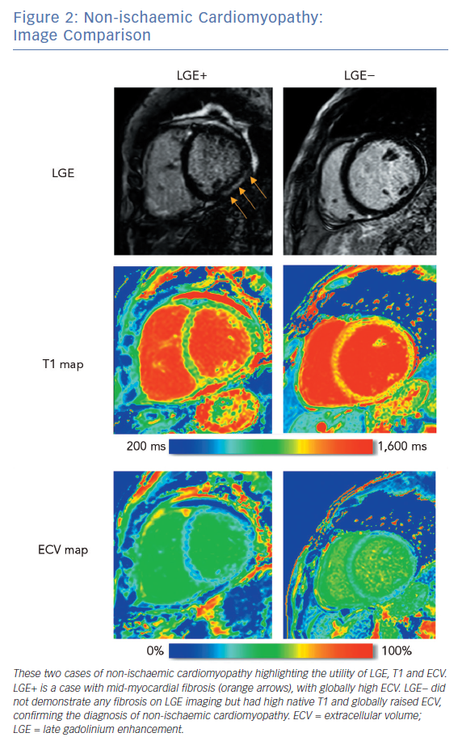
Nelson T, Garg P, Clayton RH, Lee J
Non-ischaemic Cardiomyopathy: Image Comparison
Citation: Arrhythmia & Electrophysiology Review 2019;8(3):191–201.
https://doi.org/10.15420/aer.2019.5.1

