Slide 1
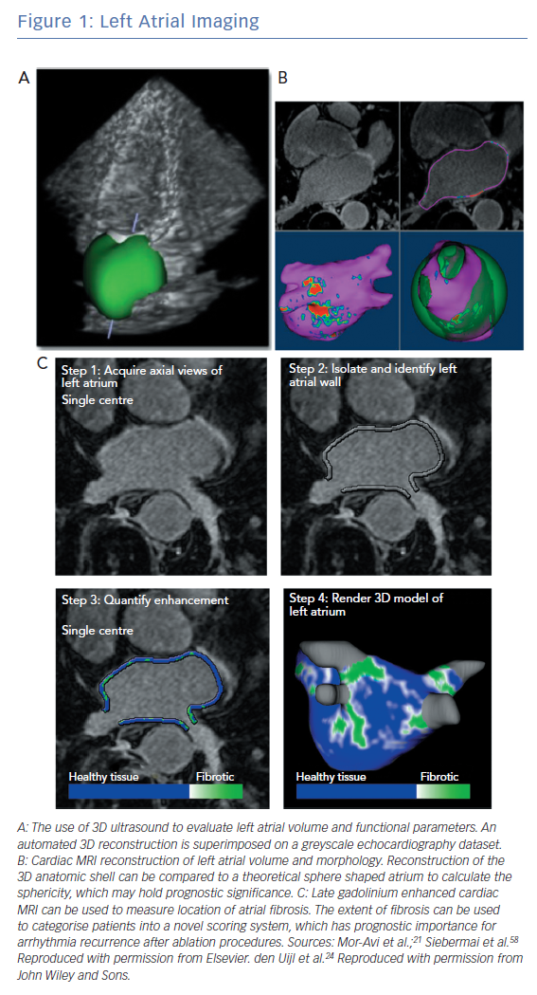
Ghannam M, Oral H
Left Atrial Imaging
Citation: Arrhythmia & Electrophysiology Review 2019;8(3):202–9.
https://doi.org/10.15420/aer.2019.18.1

