Slide 1
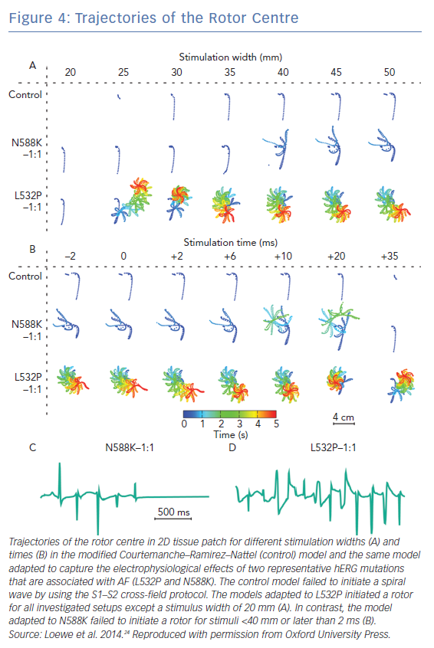
Aronis KN, Ali RL, Liang JA, Zhou S, Trayanova NA
Trajectories of the Rotor Centre
Citation: Arrhythmia & Electrophysiology Review 2019;8(3):210–9.
https://doi.org/10.15420/aer.2019.28.2

