Slide 1
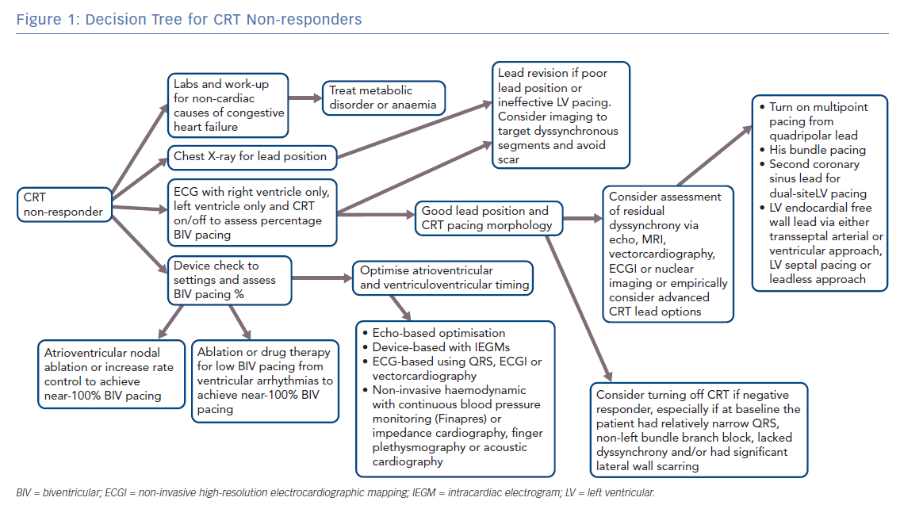
Thomas G, Kim J, Lerman BB
Decision Tree for CRT Non-responders
Citation: Arrhythmia & Electrophysiology Review 2019;8(3):220–7.
https://doi.org/10.15420/aer.2018.62.3

