Slide 1
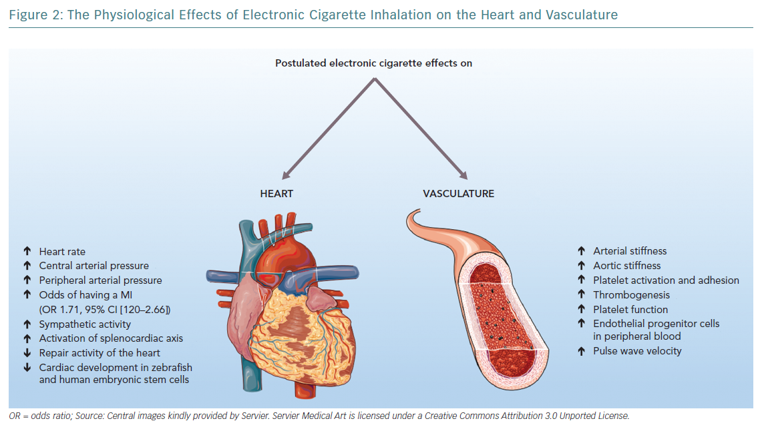
D'Amario D, Migliaro S, Borovac JA, Vergallo R, Galli M, Restivo A, Bonini M, Romagnoli E, Leone AM, Crea F
The Physiological Effects of Electronic Cigarette Inhalation on the Heart and Vasculature
Citation: European Cardiology Review 2019;14(3):151–8
https://doi.org/10.15420/ecr.2019.16.2

