Slide 1
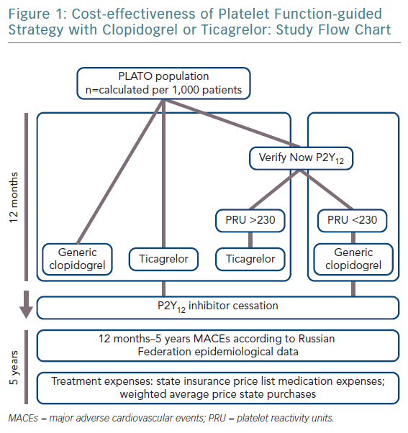
Lomakin N, Rudakova A, Buryachkovskaya L, Serebruany VL
Cost-effectiveness of Platelet Function-guided Strategy with Clopidogrel or Ticagrelor: Study Flow Chart
Citation: European Cardiology Review 2019;14(3):175–8
https://doi.org/10.15420/ecr.2018.29.2

